Slide 1
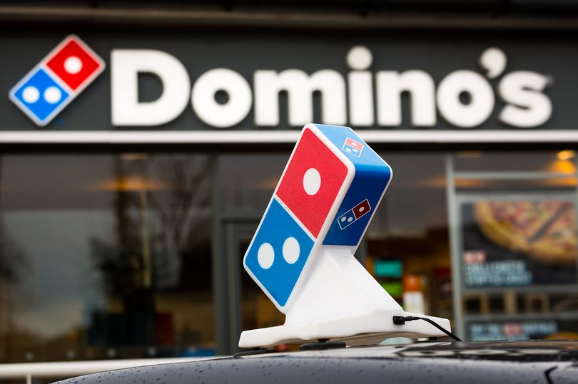
CASE Study on DOMINO’s
Shreya Maurya
(2k21/mscphy/43)

Slide 2
Table of Contents
History & Vision
Product line
Market competitors
Taglines
Brand Positioning
Marketing Campaigns
Celebrity endorsements

Slide 3
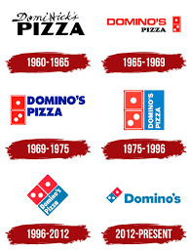
History
Domino’s is an American multinational pizza restaurant chain founded in 1960 . As of 2021,
Domino's have approximately 17,000 stores operating in 83 countries with 1327 stores in india.
Outside the United States, India has the largest number of Domino's outlets in the world
The company logo originally had three dots, representing the three stores in 1965

Slide 4
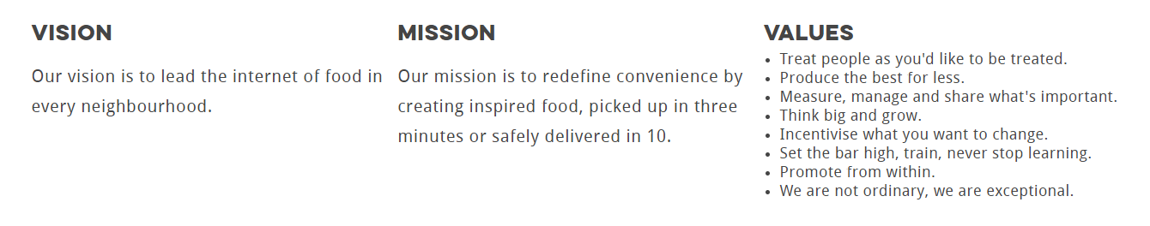
Mission,Vision & Values

Slide 5
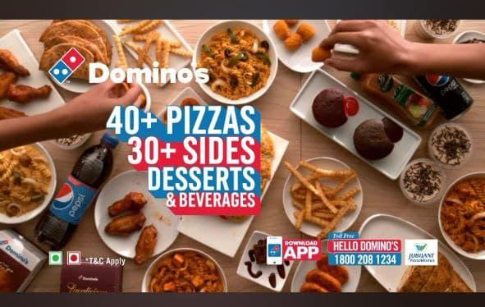
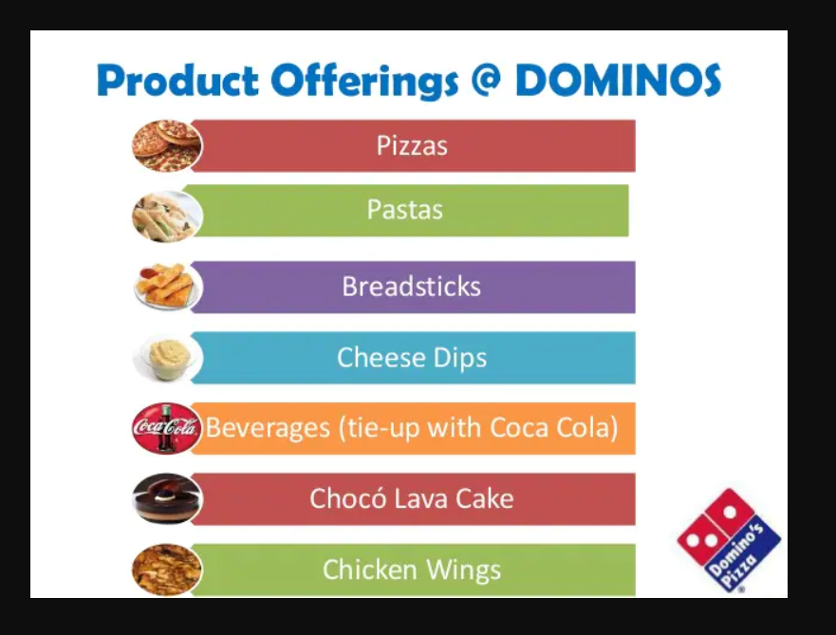

Slide 6
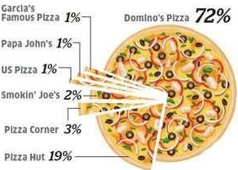
Market Competitors

Slide 7
Target Audience
The main target audience of Domino’s in India is between 18-44 in demographics. The target audience for Domino’s digital marketing strategy is the larger portion of people who would end up buying a pizza with or without a reason. From a college student who would just order a pizza for a night in with friends, to a gym freak who would end up having a pizza as their cheat meal, to a working professional who orders Domino’s while working overtime. People between this age group have smartphones and spend hours of their day on social apps who also constantly look for discounts and offers which are offered by Domino’s India.

Slide 8
Dominos emphasizes on cheese...there slogans , jingles & posts mostly revolve around cheese
TagLines
Dil , Dosti , Dominos So many cheesy ways to mix and match.
Dominos your new 3 am friend Pizza, you will fall in love with
No strings attached. Only cheese. Yeh h riston ka time
Get to the Door. It's Domino's! Domino’s. The Pizza Delivery Experts
Khusiyon ki home delivery Cheese mane Dominos

Slide 9
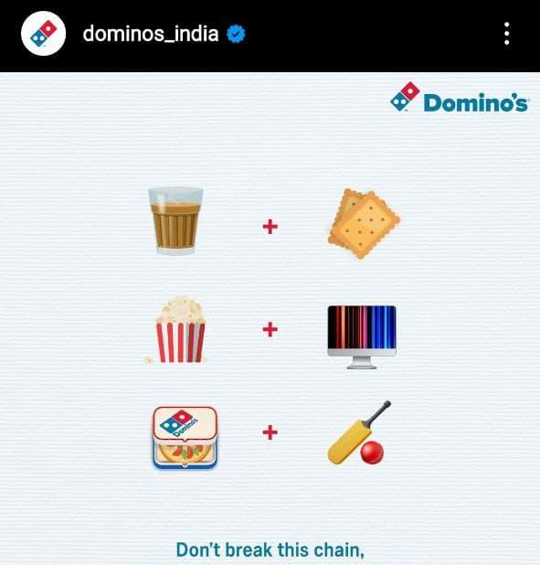
Brand Positioning
Dominos aggressively advertises during Cricket matches.
Just like biscuits are connected with tea , popcorn with movies
Similarly they try to associate pizza with cricket.

Slide 10
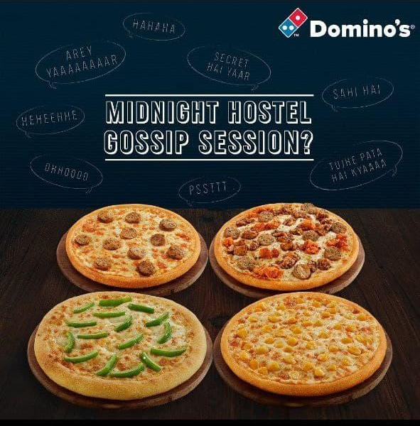
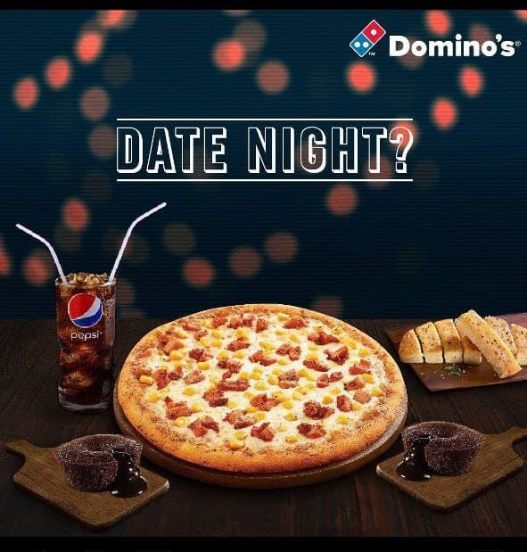
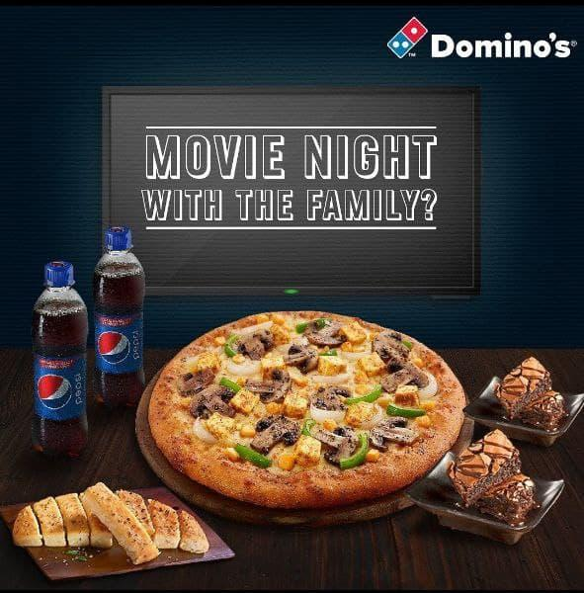
Brand Positioning
If we encounter these situations , Dominos comes into our mind

Slide 11
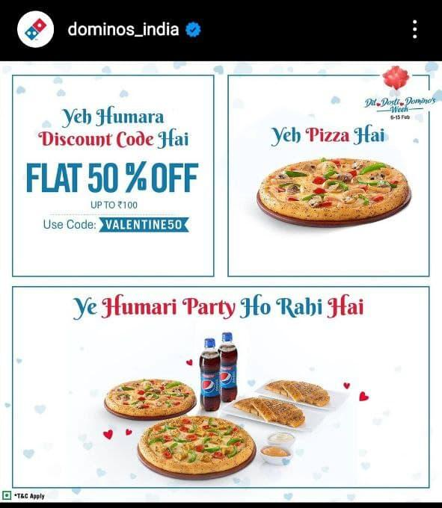
Meme Marketing
Dominos always keeps an eye on the trend and never disappoints in making creative posts. Even in the memers community.
Ye hum h,
Ye humari car h aur
Yaha party hori h…..

Slide 12
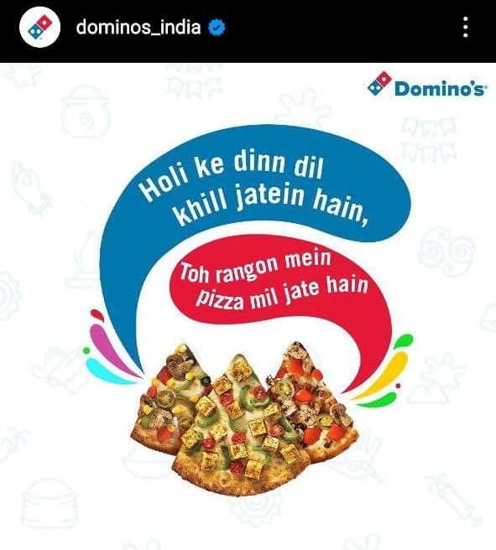
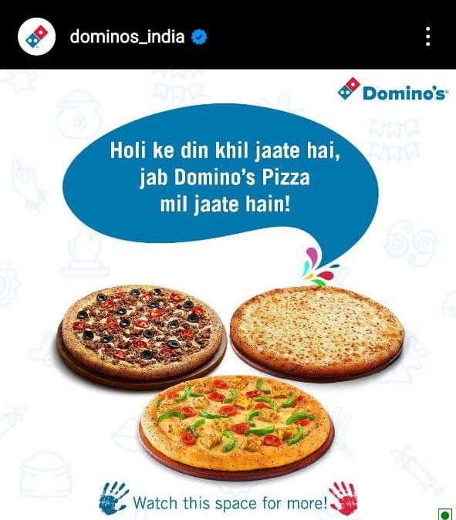
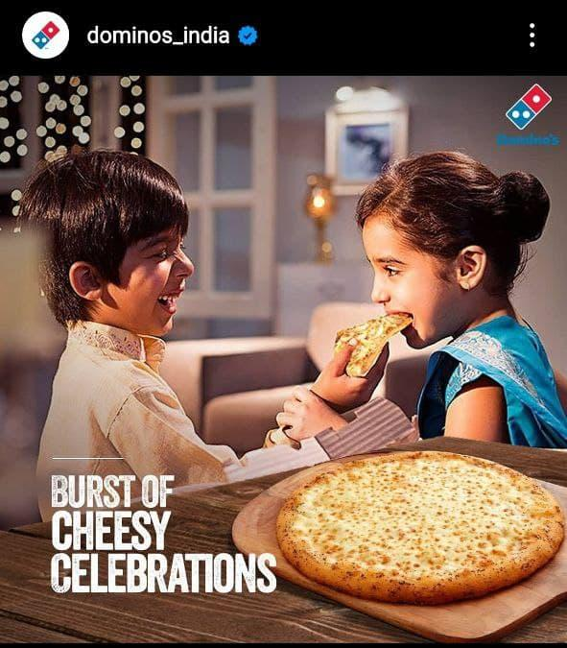
Creative punchlines on festivals

Slide 13
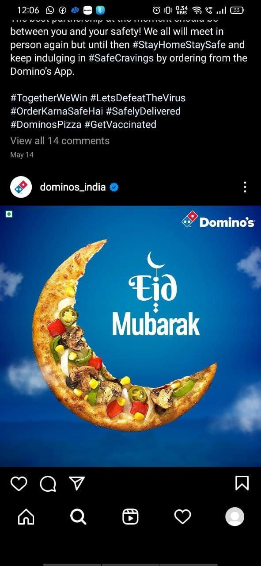
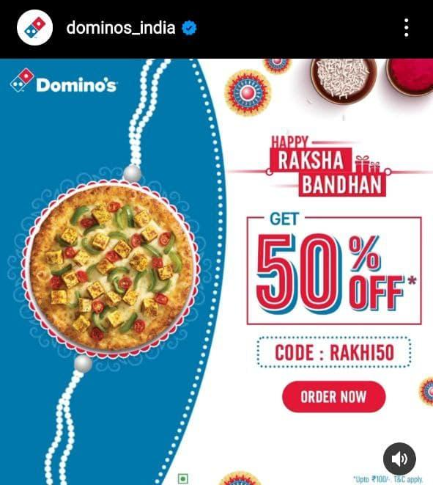
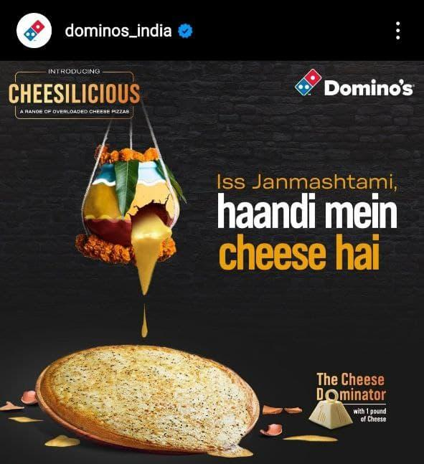
Attractive Posters aligned with the ocassion

Slide 14
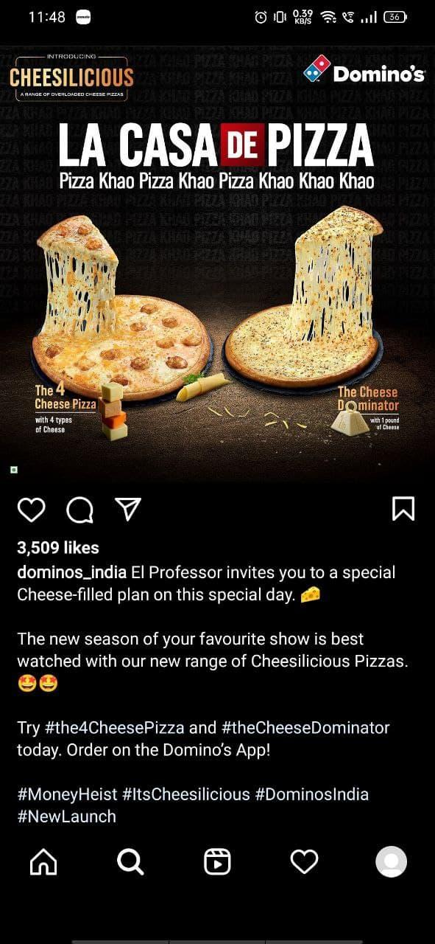
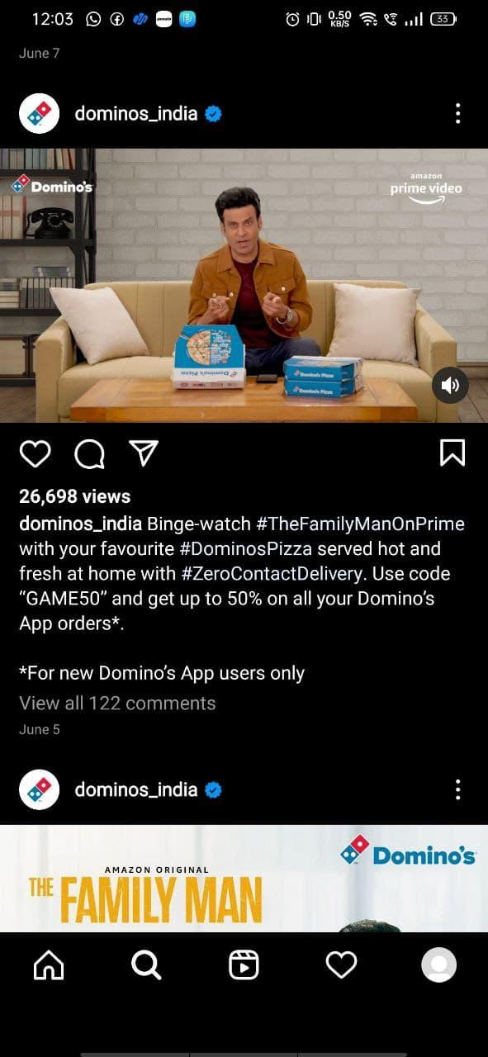
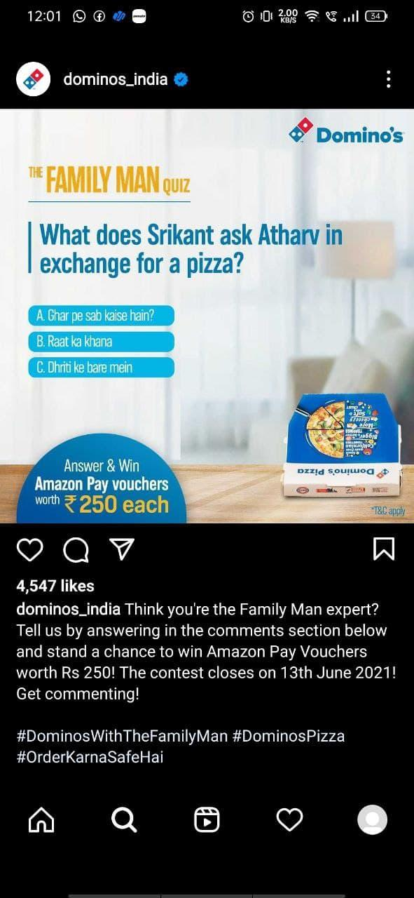
#Trends
Money Heist
La casa de papel
Jingle based on song-Bela chao
The FAMILY MAN

Slide 15
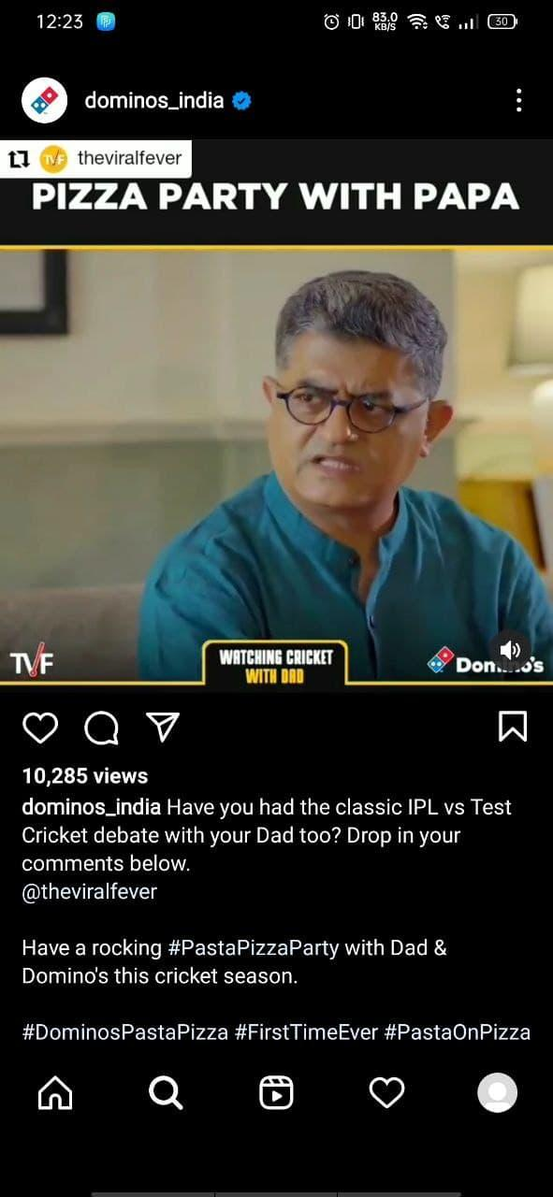
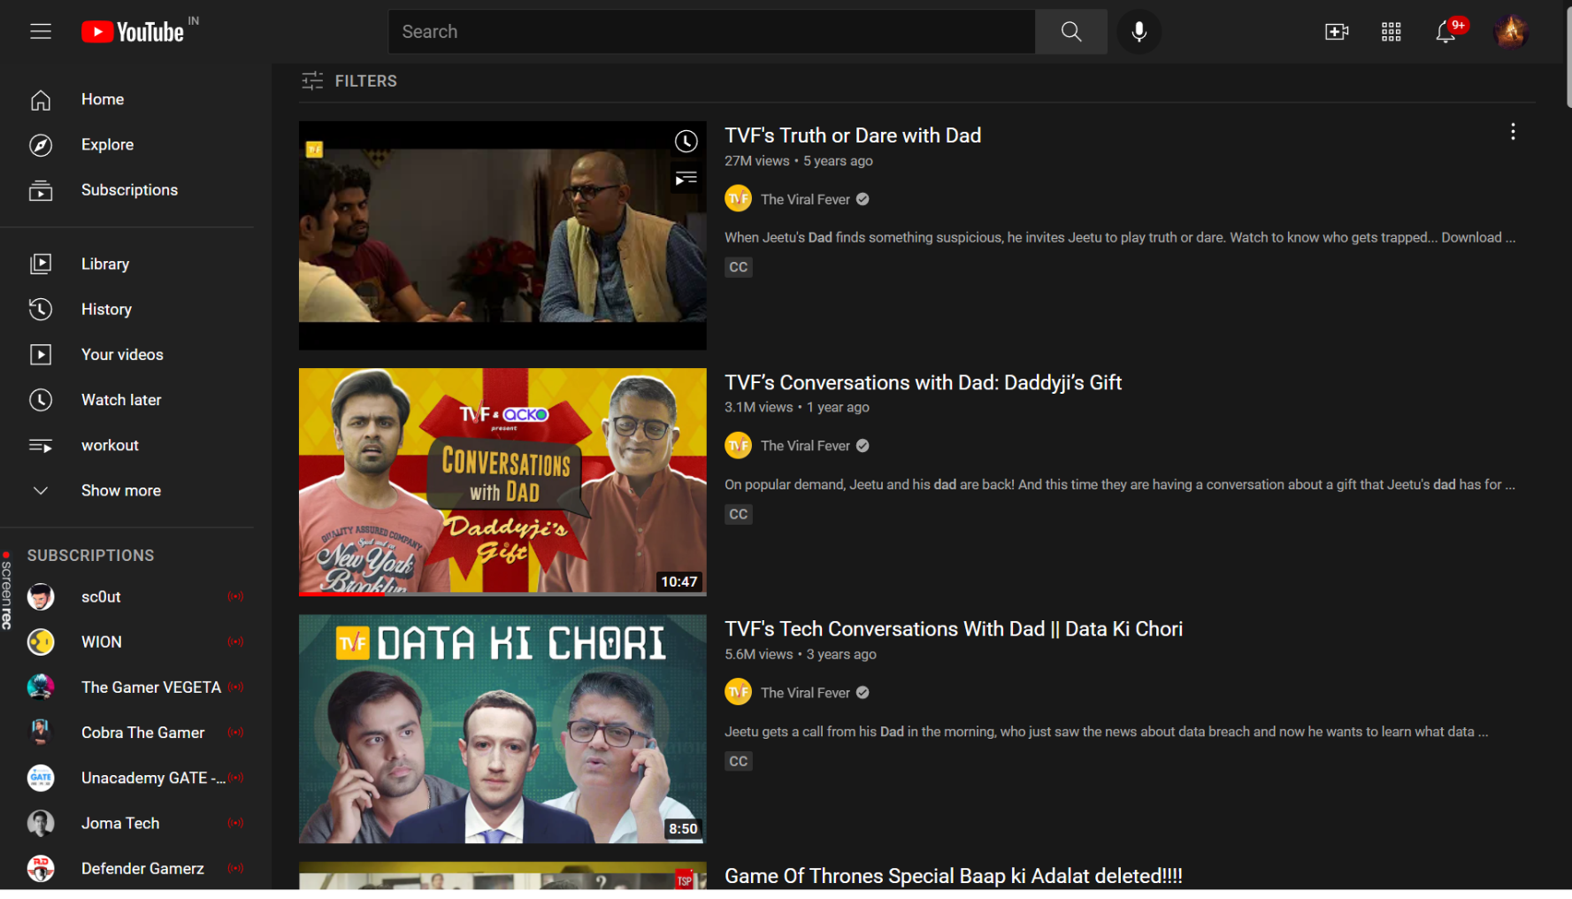
TVF is one of the leading platform in Content Creation

Slide 16

Liga de Videojuegos Profesional, known as LVP has announced their official partnership with Domino’s Pizza. Both parties began their relationship in 2017 when Domino’s Pizza partnered with the League of Legends Super Liga Orange, but have taken one step further to become the organisation’s official pizza sponsor.

Slide 17
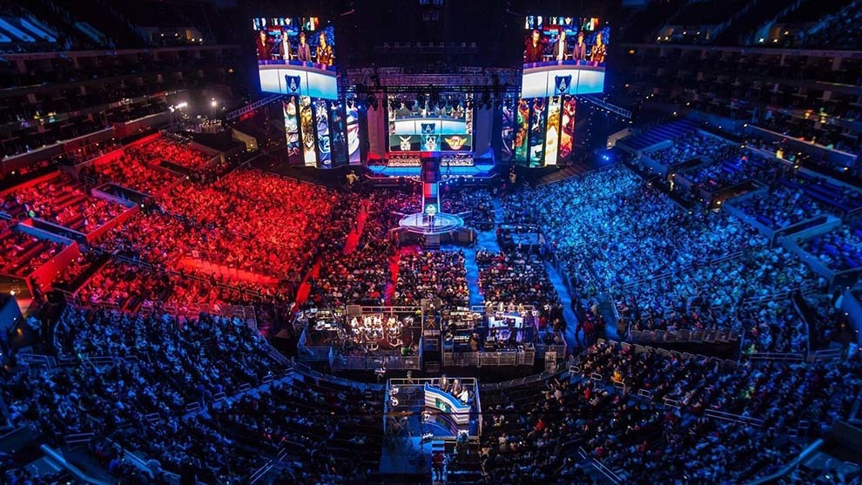

Slide 18
The Professional Videogame League (LVP), the world's leading Spanish-language eSports organization, ended 2020 with 56 million accumulated viewers, which represented a worldwide growth of 43% compared to 2019, according to company sources.
Domino’s Pizza was recognised during the broadcasts of various competitions from LVP such as League of Legends, Counter-Strike: Global Offensive and Clash Royale. LVP viewers were welcomed with discounts and special offers.
Digital Marketing Manager of Domino’s Pizza spoke before the event that: “Domino’s Pizza has already proven to be ‘the pizza of the gamers’. We were pioneers supporting electronic sports from the base, five years ago.” continued, noting that esports “has become a new form of entertainment for many young people, who come together to enjoy the games of their favourite professional teams and Domino’s wants to accompany them on these occasions so they can enjoy the best possible way.”
Esports Insider says: Domino’s Pizza and LVP have created a positive and productive partnership through the close engagement of their audience, players and staff with their brands.

Slide 19
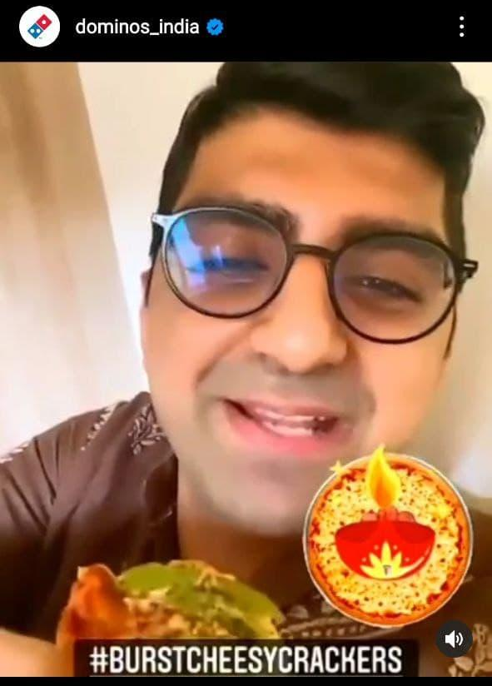
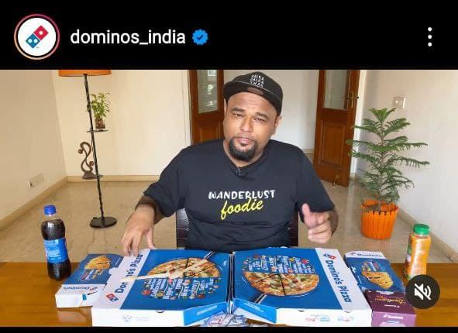
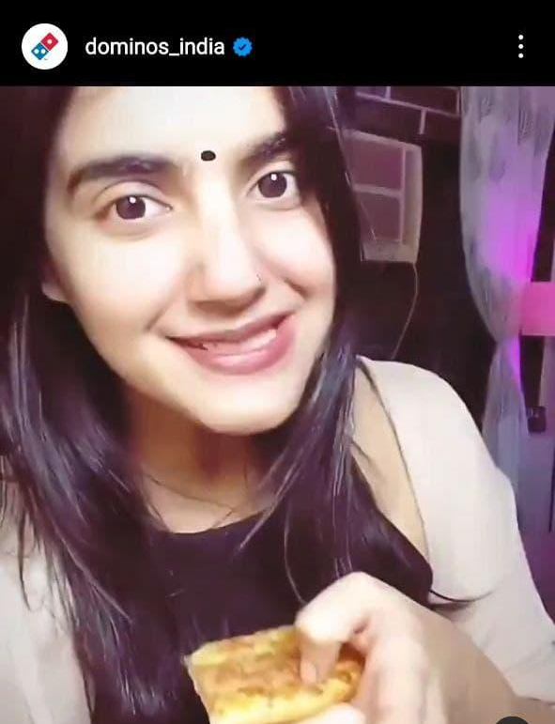
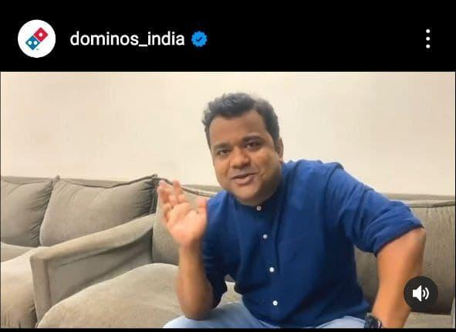
Promoting through standup comedians
Standup viewers are mostly aged between 18-44 , which is also the main target audience of Dominos.

Slide 20
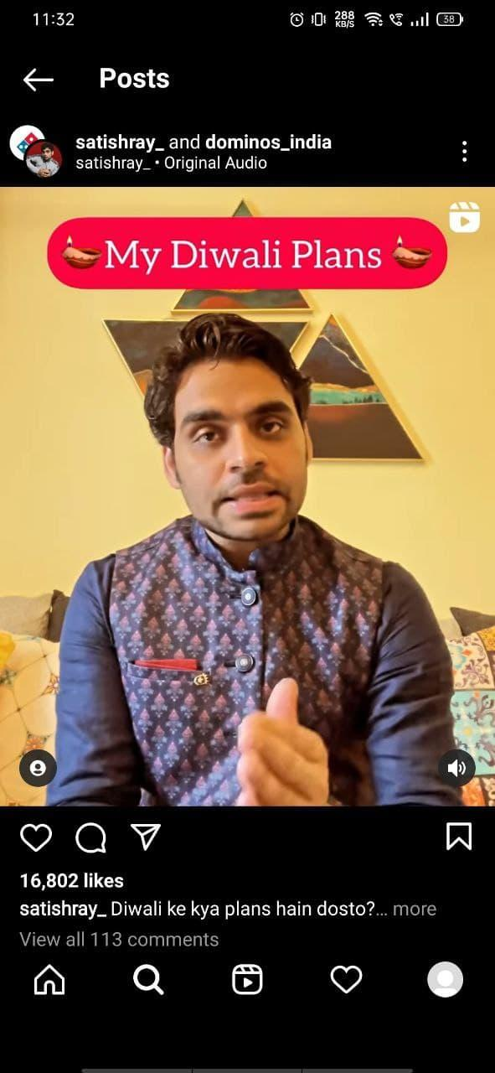
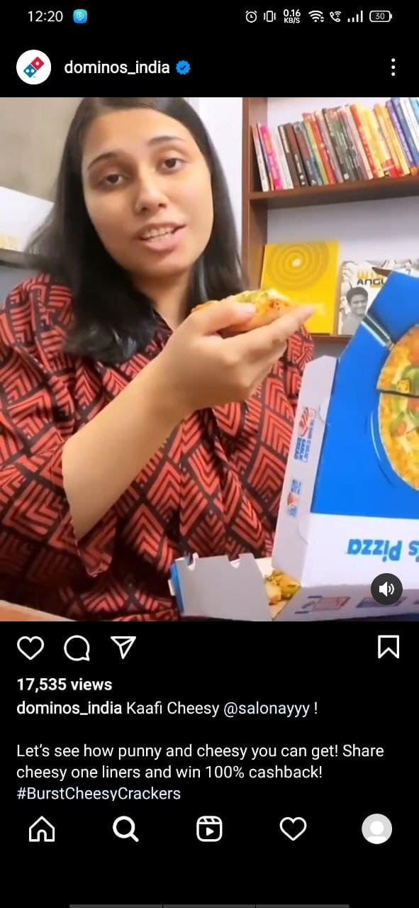
Popular YOUTUBER - Satish Ray
Lot of young indian audience are his main followers. As we know Son-papdi is quite cliche,
He Wishes Diwali and proclaims-
“ Diwali m Son-papdi nhi Dominos Pizza Gift kre”.

